Slide 1
Amazon Web Services
Let’s Cloud

Slide 2
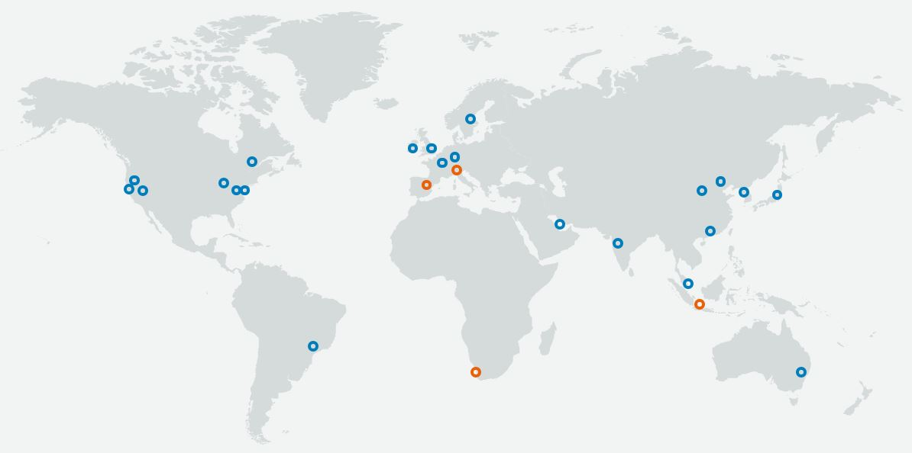
What Exactly is AWS ?
It is one of the public cloud service provider which has more than 140+ services.
knowledge portal

Slide 3
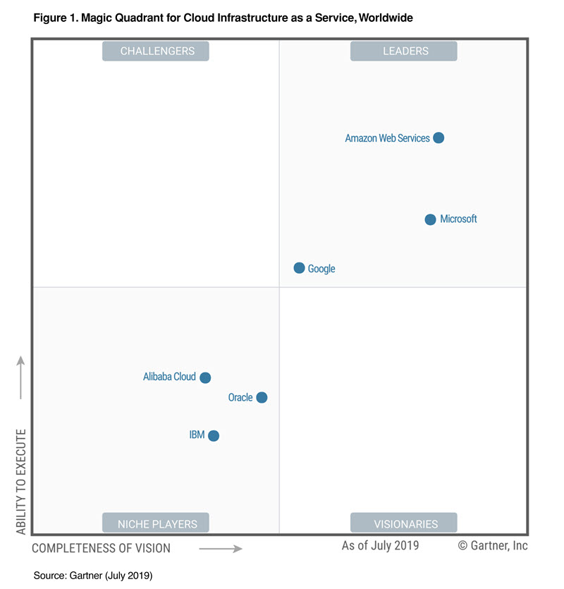
Gartner’s Magic Quadrant
knowledge portal

Slide 4
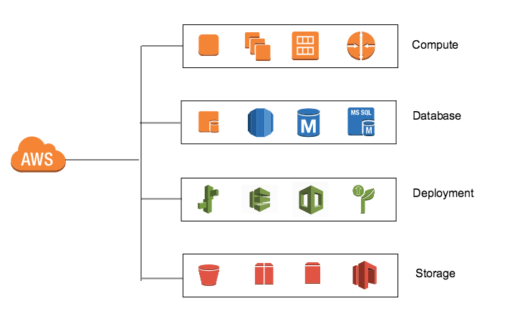
AWS Services
AWS has broad range of services available for compute, storage, database, analytics, encryption, deployment and many more.
With pay as you go model, it reduces the overall costs and help you scale your applications.
knowledge portal

Slide 5
AWS Services - Master Stroke
Real World Scenario - Storage :
Organizations used to invest tens of thousands of dollars in building their storage solutions for backups. This used to take significant amount of time and high investment.
With AWS S3, in click of an upload button, you get 99.999999999% durability in little less than a minute of work.
knowledge portal

Slide 6
Pay as you go Model
Pay as you consume model allows organizations to scale their resources well and only pay for what they have used.
Generally, the model works based on hourly costs.
This model is terrific especially due to AWS Marketplace support.
Old Bill Utility
Newer Bill
knowledge portal

Slide 7
AWS Global Infrastructure
Public Cloud Solutions

Slide 8
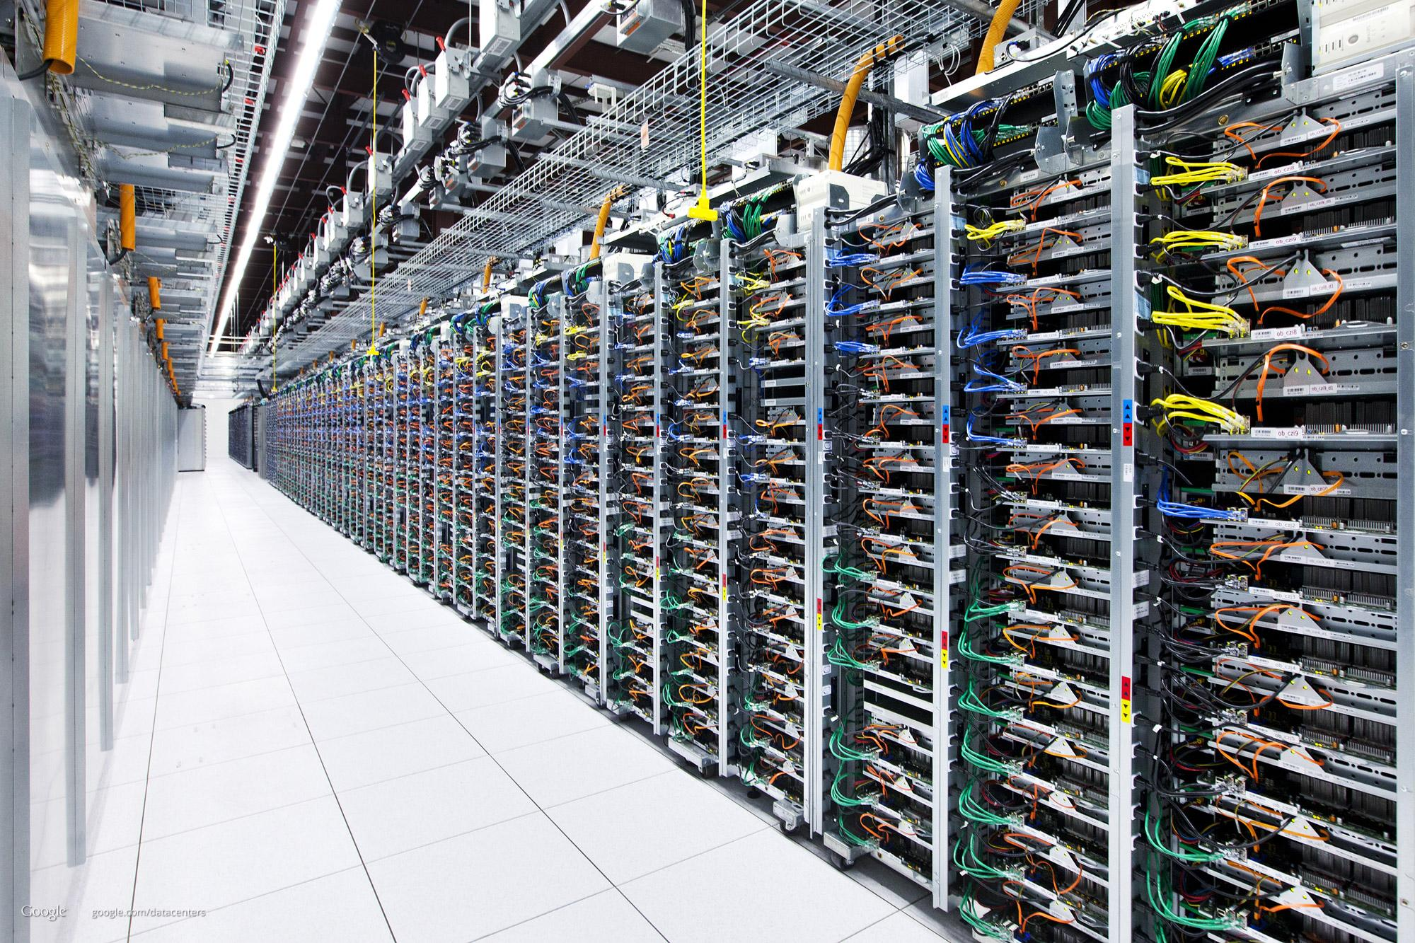
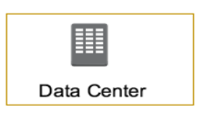
AWS Data Centers
A single data center typically has 1000s of servers.
What if data center goes down ?
knowledge portal

Slide 9
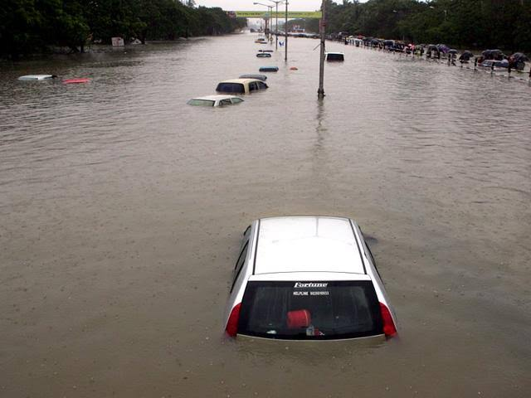
Real World Scenarios
In Mumbai, there were very heavy rains in 2005.
Lot of people were affected.
Lot of Data Centers were also affected.
knowledge portal

Slide 10
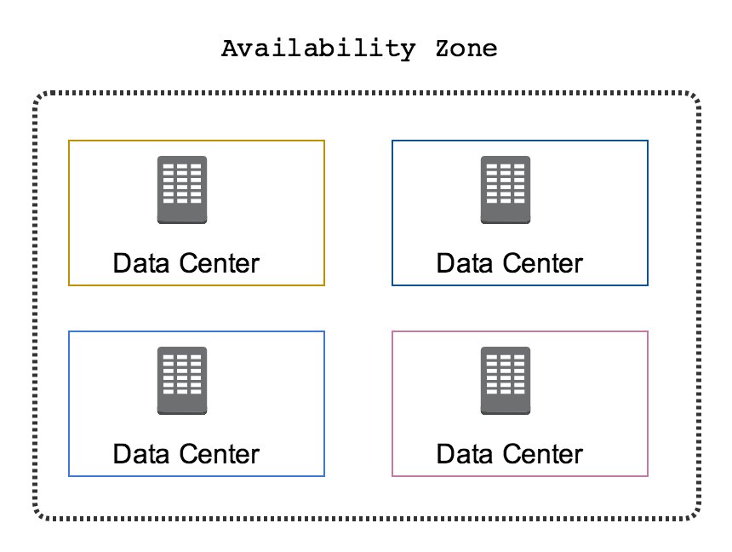
Availability Zone
AWS Data Centers are organized into Availability Zones (AZ)
Each availability zone are located at lower-risk locations.
There are multiple AZ and each of them is separate by geographic region
knowledge portal

Slide 11
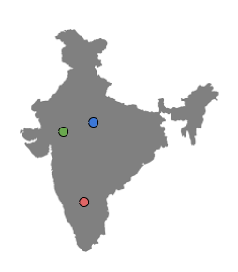
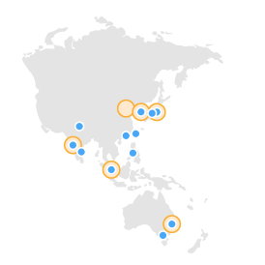
Availability Zone - Part 2
Each AZ is designed for independent failure zone.
Thus, they are physically separated.
The AZ are inter-connected with high speed private links.
Each availability zone are located at lower-risk locations.
knowledge portal

Slide 12
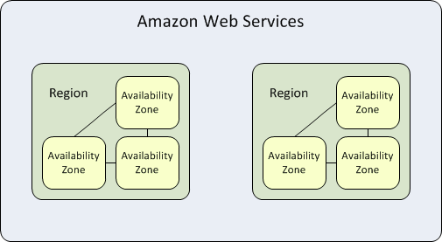
AWS Regions
Each region contains two or more availability zones.
AWS has 22 number of regions worldwide and the number keeps increasing.
knowledge portal

Slide 13
AWS Global Infrastructure
AWS currently operates on 22 regions across the world with 69 availability zones.
knowledge portal

Slide 14
Setting up the Lab
Let’s start Rolling !

Slide 15
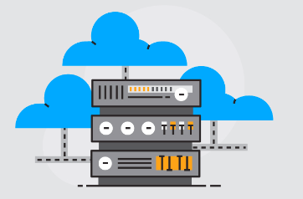
Let’s Start
i) Create a new AWS Account.
ii) Begin the course
knowledge portal

Slide 16
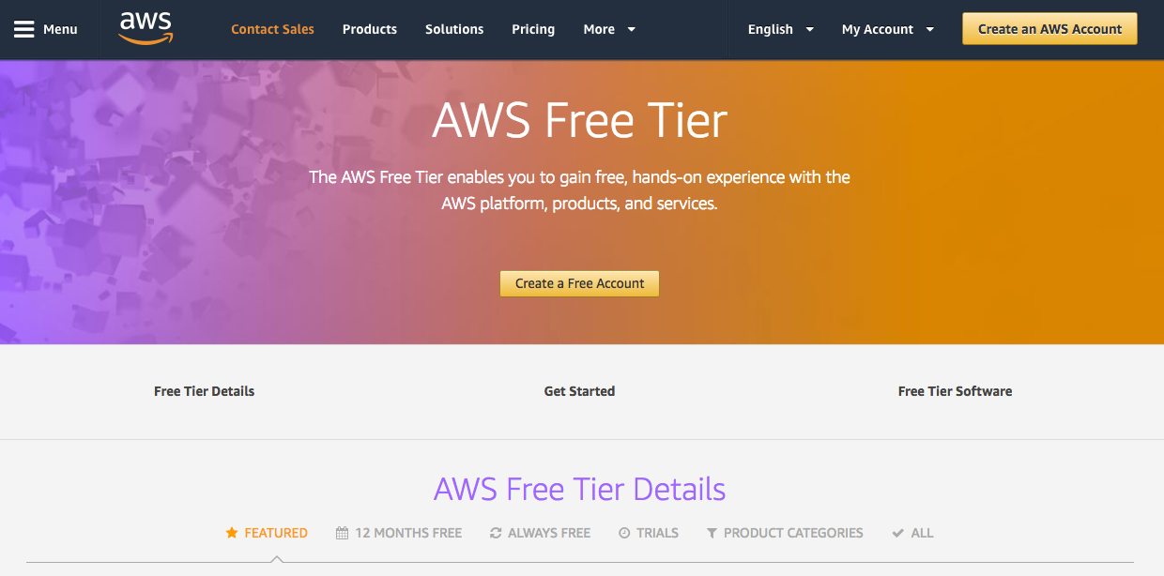
Registering an AWS Account
knowledge portal

Slide 17
Setting Up SSH Client
Let’s Begin our Journey

Slide 18

Connecting to a Server
After you have launched a server, you need to connect to it to perform administrative tasks.
Depending on OS of the server, tools to connect will change.
Server
Hey, can you host my website?
Definitely
knowledge portal

Slide 19
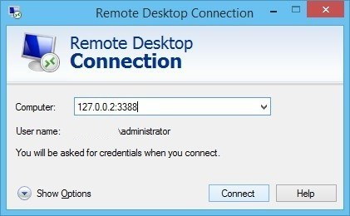
Connecting to a Server
For Linux Server, you will need a SSH Client to connect.
For Windows Server, you will need an RDP client to connect.
knowledge portal

Slide 20
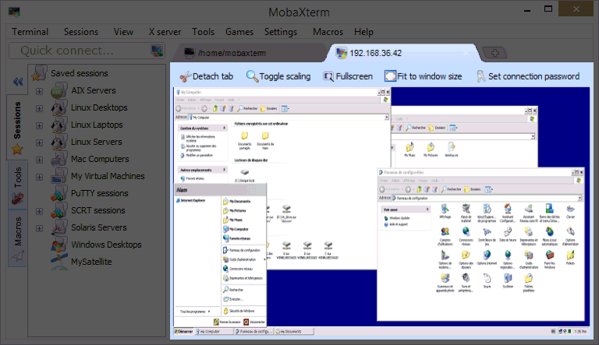
Using MobaXterm
For our labs, we will be making use of MobaXterm which comes with SSH client.
Along with SSH client, it comes with various other useful commands like telnet, curl.
MAC and Linux comes with its own terminal which has SSH client. You can skip this step.

Slide 21
Key Based Authentication
Back to Security!

Slide 22
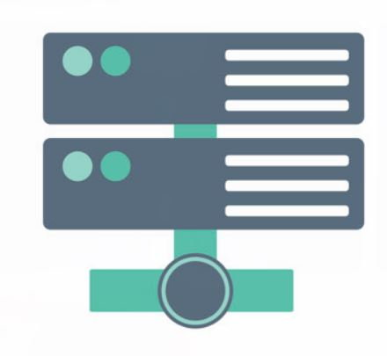

Password Based Authentication
There can be multiple methods for authentication against a system.
Password based authentication is the simplest form.
My username is admin, I want to login
Hey there, what is your password?
Laptop
Linux Server
knowledge portal

Slide 23
Login with Credentials
My username is admin, my password is 12345. I want to login.
Login successful.
Laptop
Linux Server
knowledge portal

Slide 24

Challenges with Password Based Authentication
Password based authentication is generally considered to be less-secure.
Many users write down the passwords in notepad files or as part of sticky notes.
Most users would not create a complex password that is difficult to hack.
knowledge portal

Slide 25
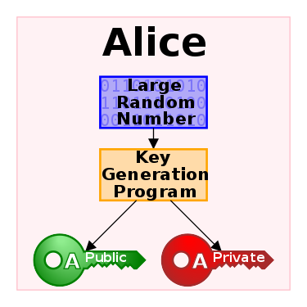
Key Based Authentication
In this type of authentication, there are two special keys that are generated.
One key is called as Public Key and second key is called as Private key.
If public key is stored in server and is used as authentication mechanism, only the corresponding private key can be used to successfully authenticate.
knowledge portal

Slide 26


Key Based Authentication
My username is admin, I want to login
Hey there, password is not allowed. You need to authenticate via the key.
Laptop
Linux Server
knowledge portal

Slide 27
Creating our First EC2 Instance
Let’s Start

Slide 28

Overview of EC2
EC2 stands for Elastic Compute Cloud.
In-short, it's a name for a server that you launch in AWS.
Server
EC2 Instance
knowledge portal

Slide 29
Important Configuration
There are certain important configuration that you need to know while launching a new EC2 instance in AWS
The CPU and Memory Size
Operating System (Linux, Windows)
Storage Capacity
Authentication Key
Security Group
EC2 Instance
knowledge portal

Slide 30
Connecting to a Server
After you have launched a server, you need to connect to it to perform administrative tasks.
Depending on OS of the server, tools to connect will change.
Server
Can you run my command?
Definitely
knowledge portal

Slide 31
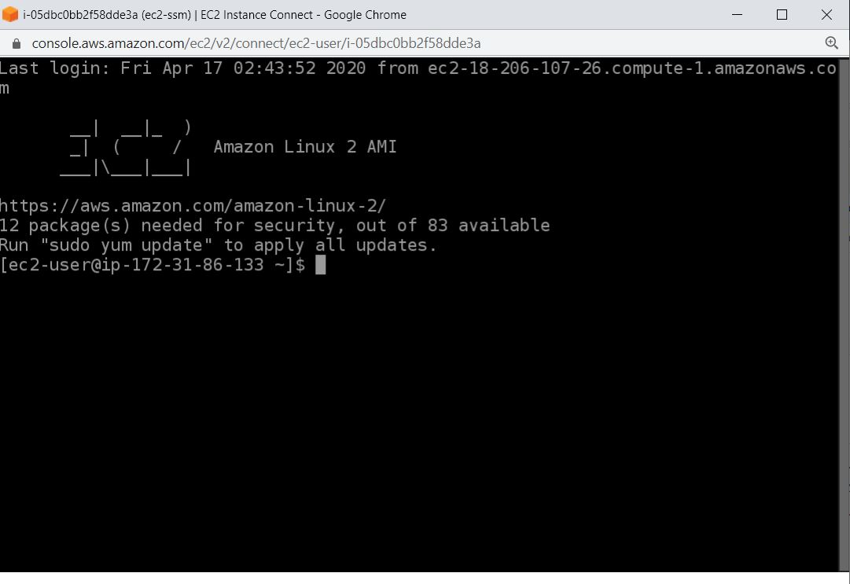
Browser Based SSH Connection
Browser Based SSH Connection allows you to directly connect to EC2 instance from browser.
No need to maintain keys or have SSH client.
knowledge portal

Slide 32
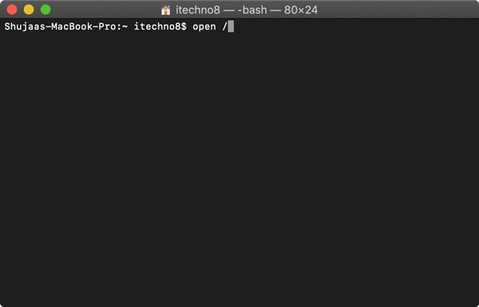
MAC Terminal
knowledge portal

Slide 33

Creating our First Website
We have our EC2 instance up and running.
Let’s go ahead and create our first website.
www.example.com
EC2 Instance
knowledge portal

Slide 34
Requirements for Website
Server.
Software on server that web-browsers can interact with (web-server)
www.example.com
S
EC2 Instance
knowledge portal

Slide 35
Understanding Firewalls
Firewall without a Fire !

Slide 36
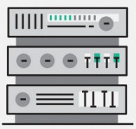
Understanding Ports
A port is a logical entity which acts as a endpoint of communication to identify a given application or process on an Linux operating system
Opening 22
SSH
Opening 80
HTTPD
User from Internet
knowledge portal

Slide 37
Understanding Firewall
Firewall is a network security system that monitors and controls incoming and outgoing network traffic based on predetermined security rules.
Firewall
Connect to 22
Opening 22
SSH
Opening 80
HTTPD
User from Internet
Deny connect to 22
Allow connect to 80

Slide 38




Allow from Trusted Block from Hackers
knowledge portal

Slide 39

Firewall in AWS
A security group acts as a virtual firewall for your instance to control inbound and outbound traffic.
Inbound Connection
EC2
Outbound Connection
knowledge portal

Slide 40
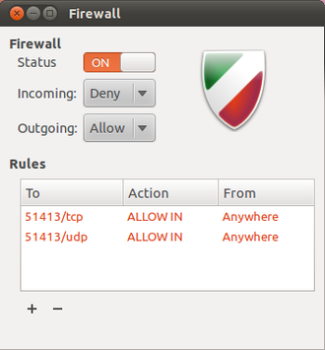
Understanding Firewalls
Firewall is a network security system that monitors and controls incoming and outgoing network traffic based on predetermined security rules.
There can be both hardware based firewalls and software based firewalls.
knowledge portal

Slide 41

knowledge portal

Slide 42
How does it do that ?
ssh serverA
Apache 80
SSH 22
FTP 21
SMTP 25
MySQL 3306
IP : 10.0.5.57
IP : 112.20.50.60

Slide 43
AWS Budgets
Free Tier is Important

Slide 44
Overview of AWS Budgets
AWS Budgets gives you the ability to set custom budgets that alert you when your costs or usage exceed (or are forecasted to exceed) your budgeted amount.
Let’s understand this with an example:
John has created a new AWS account and want to be under free tier.
He wants to be notified whenever there is a charge of more then $1
knowledge portal

Slide 45
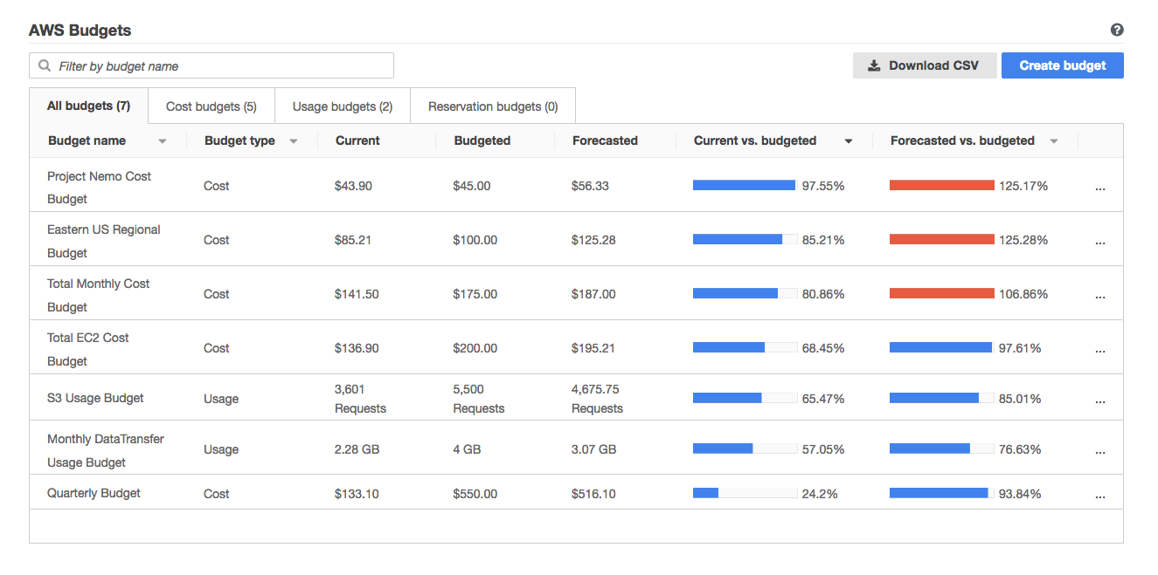
knowledge portal

Slide 46
Virtual Private Cloud
Do things the right way

Slide 47
Let’s understand with a use-case
John works as Finance manager. He is migrating to a new city because of his job and plans to live in an apartment.
House 1
House 2
knowledge portal

Slide 48
Analogy in terms of servers
5 servers are planned to be migrated to cloud.
The location where they can be launched in AWS is VPC.
VPC
VPC
knowledge portal

Slide 49
Let’s understand with a use-case
John has decided to buy a new house. For additional income, he has decided to rent part of hise house . John decides to partition his house.
Partition 1
Partition 2
knowledge portal

Slide 50
Let’s understand with a use-case
Among the 5 servers, we have decided following architecture:
Launch 3 servers in first partition (subnet 1)
Launch 2 servers in second partition (subnet 2)
Subnet 1
Subnet 2

Slide 51
Additional Layer of Security - Partition Wise
John can decide to have additional layer of security in each partition.
Partition 1
Partition 2
knowledge portal

Slide 52
Additional Layer of Security - Partition Wise
John decides to build two entrance so that individuals in partition 1 can directly go out of the house.
Hypothetically imagine that no doors for partition 2 so no one can go out.
Partition 1
Partition 2
knowledge portal

Slide 53
Additional Layer of Security - Partition Wise
Solutions Architect creates a route so that servers from subnet 1 can connect to the internet.
For subnet 2, no routes has been created hence servers cannot reach the internet.
Subnet 1
Subnet 2
knowledge portal

Slide 54
Inter-Communication
There can be a need for servers from two subnets to speak with each other.
So you can create a route that can allow communication between two subnets.
Subnet 1
Subnet 2
knowledge portal

Slide 55
Inter-Communication
There can be a need for servers from two subnets to speak with each other.
So you can create a route that can allow communication between two subnets.
Subnet 1
Subnet 2
knowledge portal

Slide 56
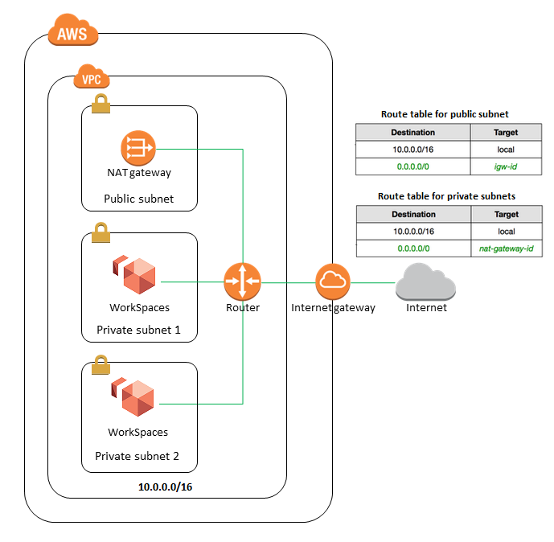
Important Learnings
Every EC2 instance that we create should be under a VPC.
EC2 instance launched in a VPC will be protected or not protected based on configuration of VPC.
Architecture changes when you go into more technical aspect.

Slide 57
Internet Gateway
Connect to Internet

Slide 58

Simple Analogy
You have recently moved to a new house.
You have a laptop and you want to watch some Youtube videos.
But there is no Internet connectivity in your house.
knowledge portal

Slide 59


VPC Network
The EC2 instances inside VPC will be able to communicate with each other.
They will NOT be able to connect to Internet.
Internet
10.77.0.5
10.77.0.6
VPC - 10.77.0.0/16
knowledge portal

Slide 60
Internet Gateway
An internet gateway is a component that allows communication between your VPC and the internet.
It allows both inbound as well as outbound communication.
IGW
10.77.0.5
10.77.0.6
Internet
VPC - 10.77.0.0/16
knowledge portal

Slide 61
VPC Peering
Let’s Route

Slide 62


VPC Peering
VPC peering is a network connection between two VPC that enables the communication between instances of both the VPC.
172.31.0.0/16
10.77.0.0/16
knowledge portal

Slide 63
Today’s Architecture - 1
First VPC - 172.31.0.0/16
Secondary VPC - 10.77.0.0/16
172.31.0.0/16
10.77.0.0/16
knowledge portal

Slide 64
Today’s Architecture - 2
10.66.0.0/16
172.31.0.0/16
10.77.0.0/16

Slide 65
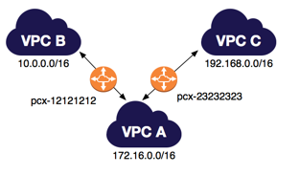
Things to Remember
VPC Peering is now possible between regions.
VPC Peering does not act like a Transit VPC
knowledge portal

Slide 66
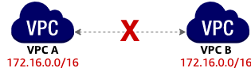
Unsupported VPC Peering Configurations - 1
You cannot create a VPC peering connection between VPCs with matching or overlapping IPv4 CIDR blocks.
knowledge portal

Slide 67
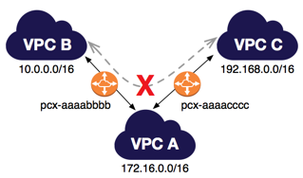
Unsupported VPC Peering Configurations - 2
You have a VPC peering connection between VPC A and VPC B (pcx-aaaabbbb), and between VPC A and VPC C (pcx-aaaacccc).
There is no VPC peering connection between VPC B and VPC C. You cannot route packets directly from VPC B to VPC C through VPC A.
knowledge portal

Slide 68
Network ACL
Multiple Layers for Defense

Slide 69

Understanding the Basics
A network access control list (ACL) is an optional layer of security for your VPC that acts as a firewall for controlling traffic in and out of one or more subnets.
Security Group works at an EC2 instance level.
Network ACL works at a Subnet Level.
Public/Private Subnets
Security Group
Network ACL
knowledge portal

Slide 70
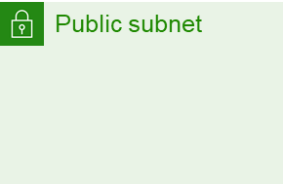
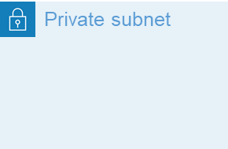
Understanding with Use-Case
Company XYZ is getting lot of attacks from a random IP 128.190.12.32. The company has more than 500 servers and Security team decided to block that IP in firewall for all the servers.
How to go ahead and achieve that goal ?
250 EC2
Network ACL
250 EC2
DENY 128.190.12.32

Slide 71
Important Pointers
Each subnet in your VPC must be associated with a network ACL. If you don't explicitly associate a subnet with a network ACL, the subnet is automatically associated with the default network ACL.
Default NACL allows all inbound and outbound IPv4 traffic and, if applicable, IPv6 traffic.
You can associate a network ACL with multiple subnets. However, a subnet can be associated with only one network ACL at a time.
knowledge portal

Slide 72
Elastic Load Balancer
Managed Services are the best

Slide 73
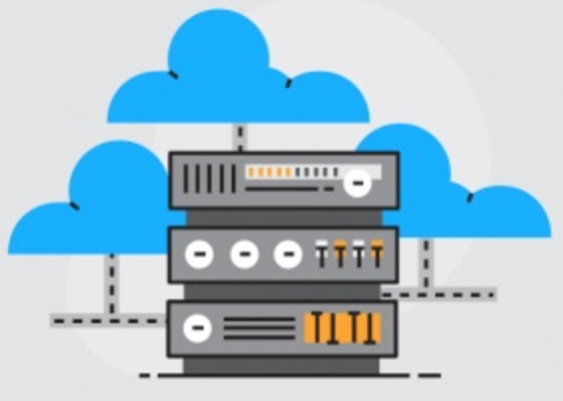
Improvement Area
Single point of failure should be avoided
50%
50%
knowledge portal

Slide 74
Revised Configuration
Single point of failure should be avoided
50%
50%
knowledge portal

Slide 75

Better Configuration
Elastic Load Balancer
50%
knowledge portal

Slide 76
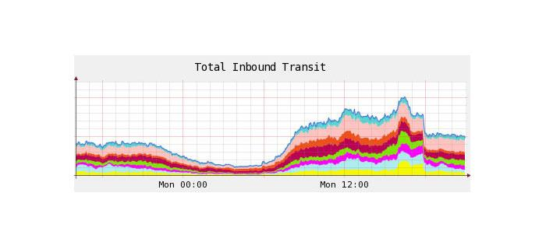
Introduction to ELB
Elastic Load Balancer allows us to distribute the incoming traffic to multiple instances similar to what a traditional load balancer does.
ELB is capable of handling rapid change in the network traffic patterns.
Since it’s managed service, client does not have to worry about the high availability related aspects.
knowledge portal

Slide 77
Classic Load Balancers
First generation Load Balancers

Slide 78


Understanding Classic Load Balancers
These are older generation of load balancers.
Provides basic set of features for HTTP, HTTPS, TCP and SSL protocols.
Classic ELB
knowledge portal

Slide 79
Limitation of Classic Load Balancers
Does not support native HTTP/2 protocol.
IP address as targets are not supported.
Path based routing is not supported. (eg: /images should go to server 1 & /php to server 02)
Many Many more …..
knowledge portal

Slide 80
AWS Tags
Meta-Data to AWS Resources

Slide 81

Understanding the Basics
A tag is a label that you assign to an AWS resource.
Each tag consists of a key and an optional value, both of which you define.
Let’s understand this with a simple use-case:
There are three EC2 instances running. How will you identify them?
email-server
payment-app
compliance-system
knowledge portal

Slide 82
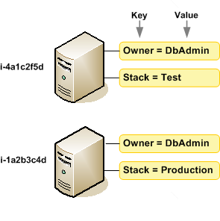
Architecture Perspective
A resource can have multiple tags assigned to it.
knowledge portal

Slide 83
Important Restrictions
AWS has hundreds of services. Not all of them support tagging.
Maximum number of tags per resource – 50
Tag keys and values are case-sensitive.
.
knowledge portal

Slide 84
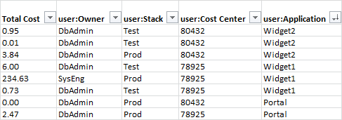
Important Use-Cases for Tags - Billing
Tags can be integrated in Billing and that allows customers to understand their AWS bill in a granular way.
knowledge portal

Slide 85
Important Use-Cases for Tags - IAM
Tags can be used with IAM to control the access to resources.
Example Use-case:
Allow Alice to only delete resources which has a tag of env as development.
env: production
env: development
knowledge portal

Slide 86
Follow the Tagging Strategy
It is important to have a consistent and effective tagging strategy.
Example
Alice creates a resource with the tag of key of env and value of production
Matthew creates a resource with the tag of Env and value of Production
Follow the AWS Tagging Strategies document.
knowledge portal

Slide 87
EC2 Auto Scaling
Up and Down, Round and Round

Slide 88
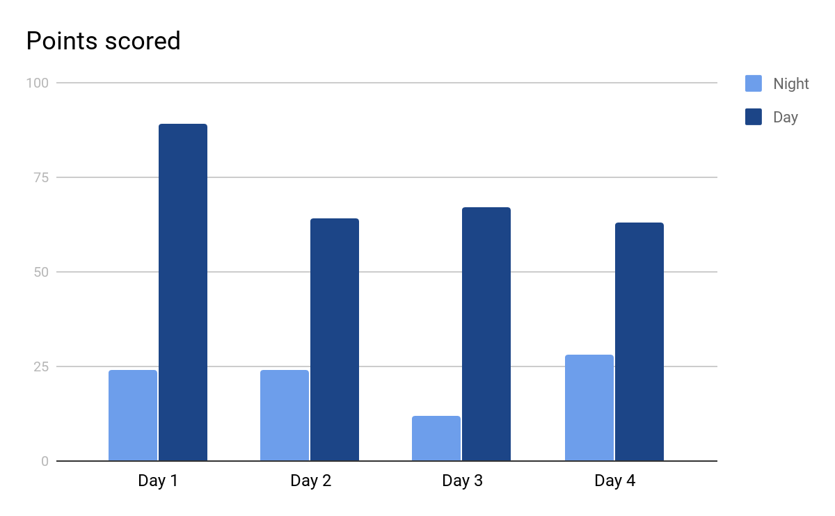
Understanding Scalability
.
Scalability is the ability of a system to change in size depending on the needs.
Infrastructure should scale to support changing in traffic patterns.
knowledge portal

Slide 89
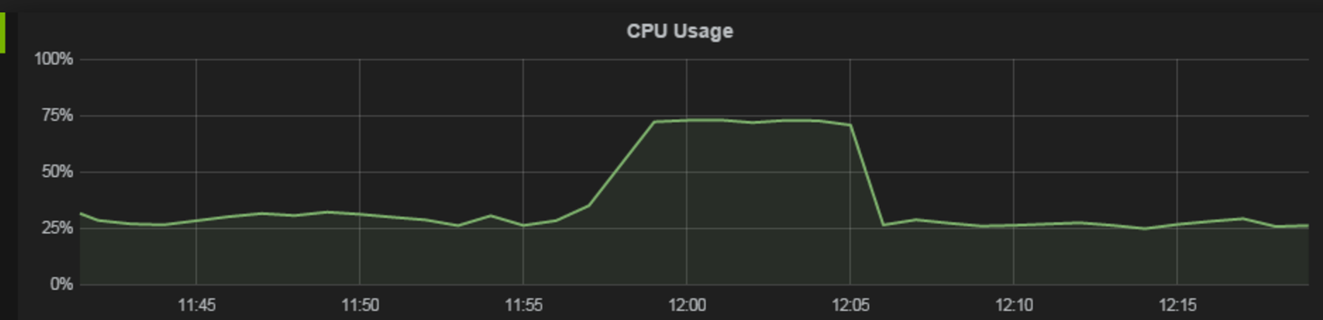
Launch and Remove Servers Based on Load
What if new servers automatically get launched on high load?
Simple Scaling Policy:
Base: 2 servers
Scalable :
If average CPU utilization > 60% ; add two more instance
If average CPU utilization < 30% ; remove two instance
knowledge portal

Slide 90
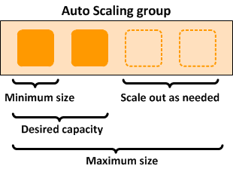
Overview of EC2 Auto-Scaling
Amazon EC2 Auto Scaling helps you maintain application availability and allows you to automatically add or remove EC2 instances according to conditions you define.
Example Scenario:
Minimum: 2 EC2 instance
Maximum: 10 EC2 instance
Threshold: 50% of CPU

Slide 91
Multiple Types of Scaling
Type of Scaling | Description
Scheduled Scaling | Servers are scaled based on a specific schedule. For example, every week the traffic to your web application starts to increase on Wednesday, remains high on Thursday, and starts to decrease on Friday
Dynamic Scaling | Follow the demand curve for scaling activities. CPU Utilization higher then 90%
Predictive Scaling | Predictive Scaling has machine learning algorithms that detect changes in daily and weekly patterns, automatically adjusting their forecasts.
knowledge portal

Slide 92
CloudWatch
Monitor all the time

Slide 93
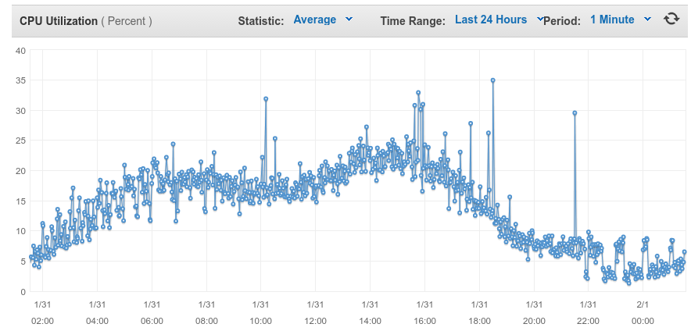
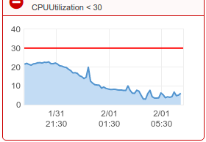
Basics of CloudWatch
CloudWatch is a Monitoring service for your AWS Cloud Resources & Applications.
We can use CloudWatch to collect and monitor log files, set alarms and also automatically react to changes in the AWS Resources.
knowledge portal

Slide 94

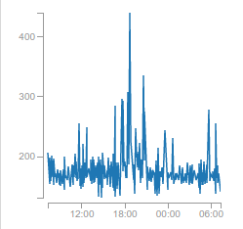

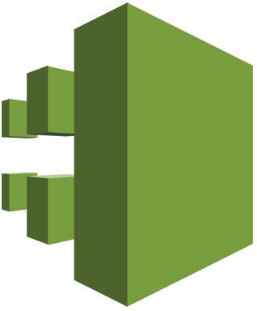
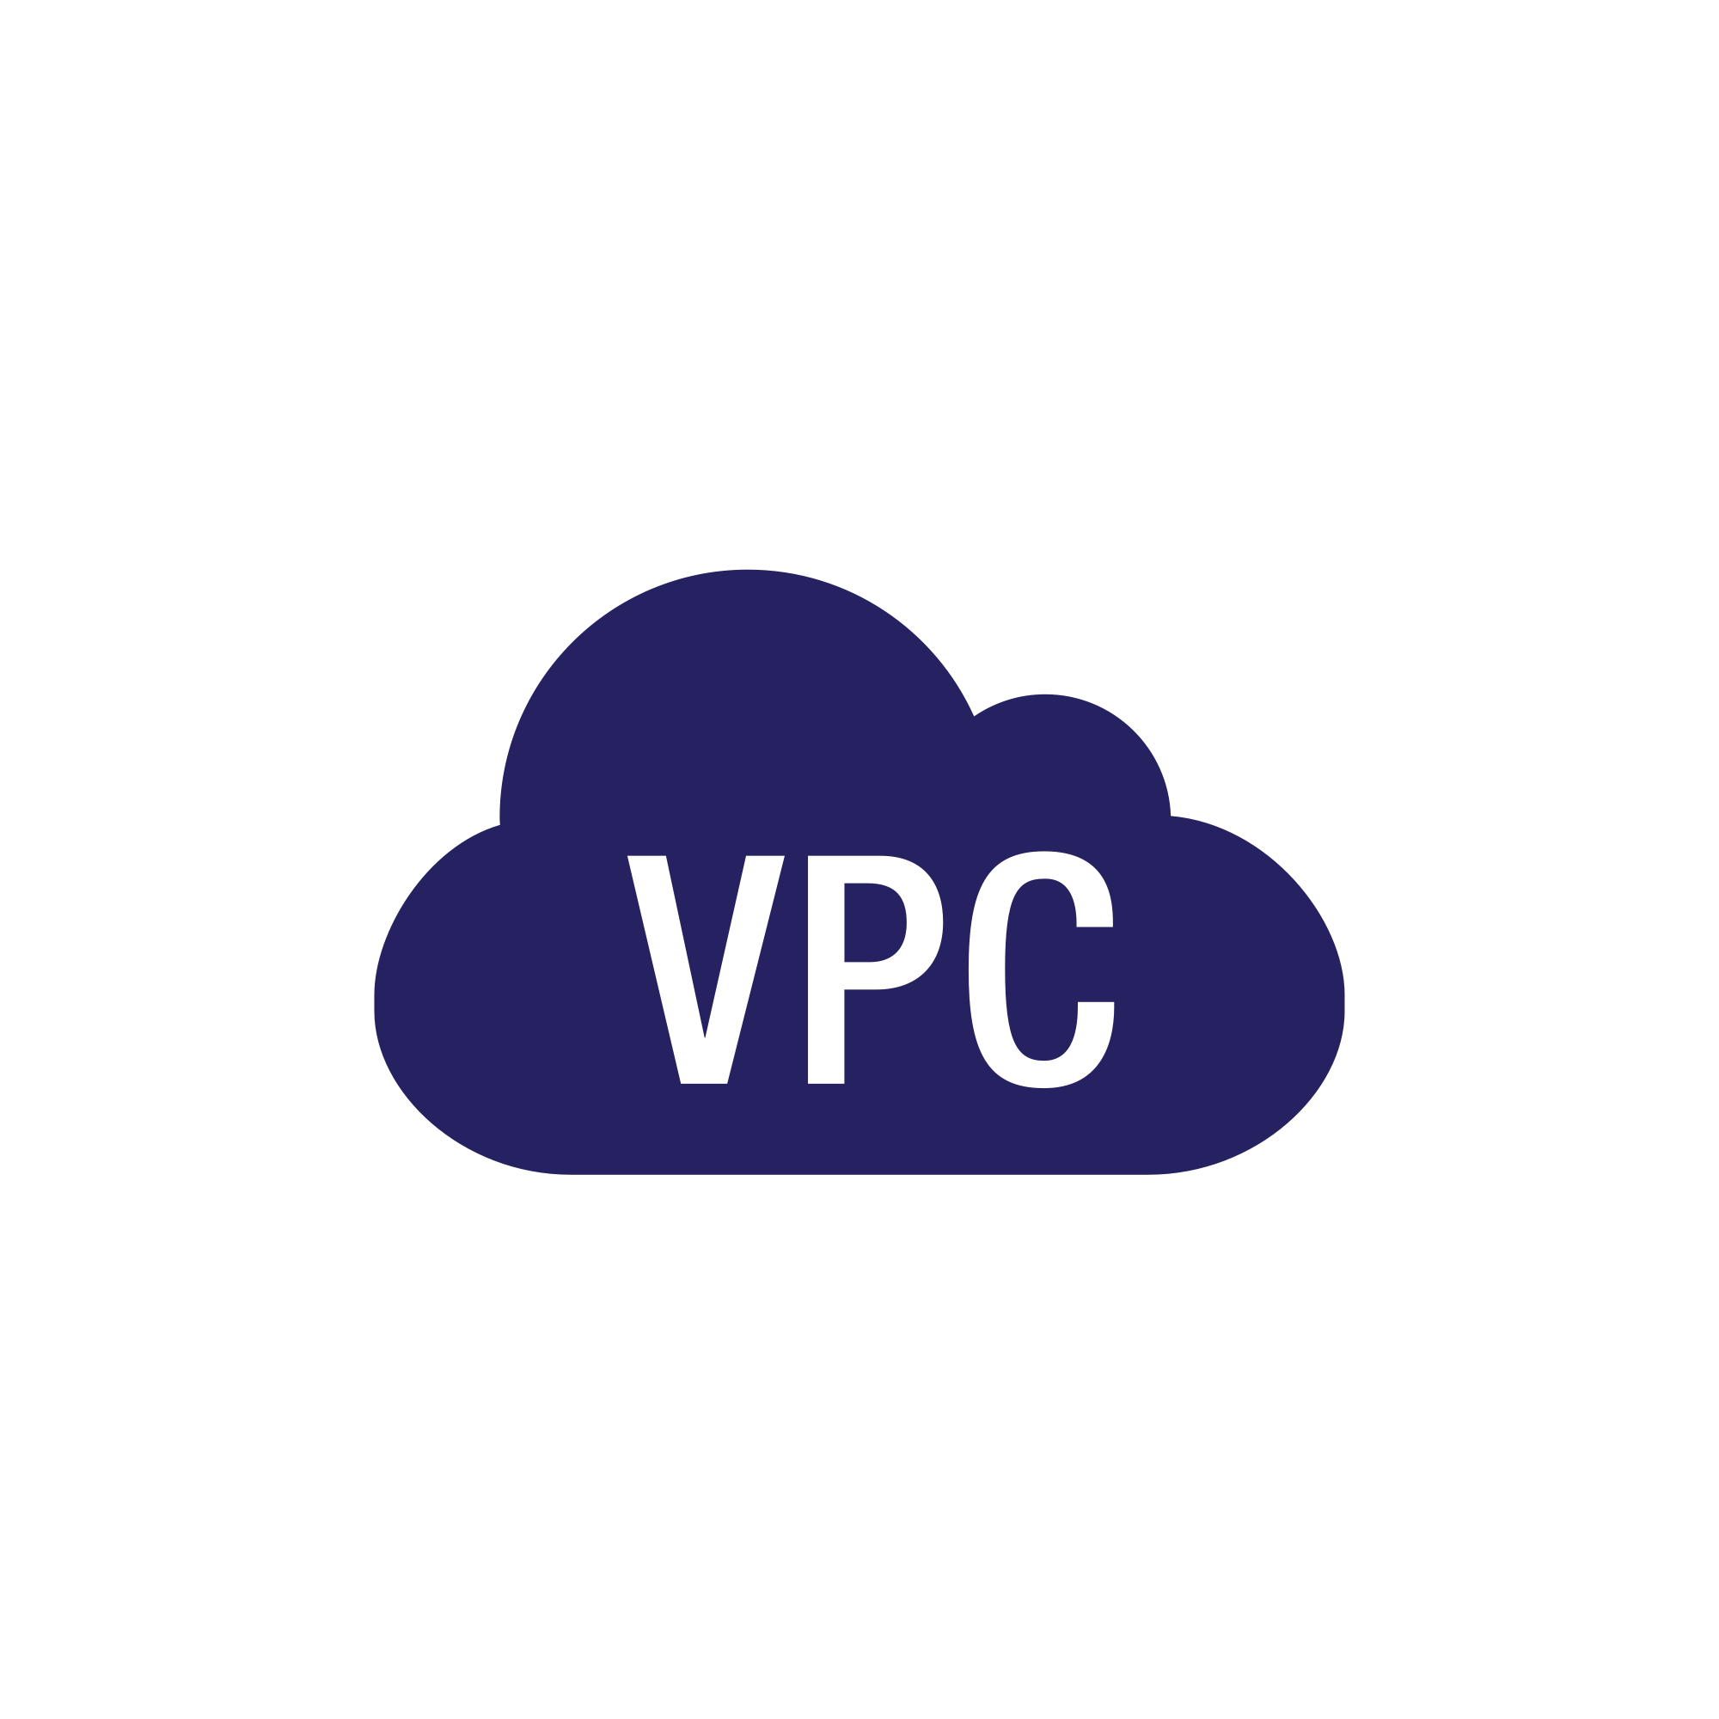
CloudWatch Events Source
Server Logs
CloudTrail
knowledge portal

Slide 95
Simple Notification Service
Notification Service

Slide 96



Let’s Message
SNS stands for simple notification service.
SNS is a fully managed messaging and mobile notification service for delivering messages to the subscribed endpoints.
SNS Topic
knowledge portal

Slide 97
Use-Cases for SNS
AWS CloudWatch integrates well with SNS.
Whenever a disk usage of a server exceeds 95%, send an EMAIL and SMS notification to the NOC team.
Whenever a server load in production is more than 90%, send and email and SMS notification.
knowledge portal

Slide 98
Serverless Computing
Cloud is not on Clouds

Slide 99
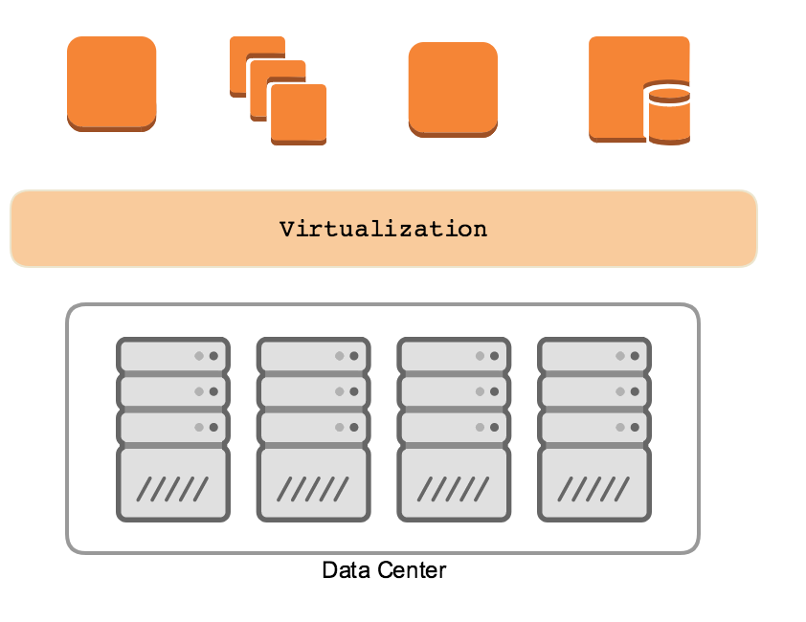
Let’s look into traditional architecture
Cloud from behind the scenes is data center only.
knowledge portal

Slide 100
Challenges with server based architecture
Virtualization allows us to run multiple OS on a single hardware.
Understand the capacity requirements.
Launch EC2 instance in HA
Install the python packages, pip, package dependencies etc.
Take care of security, patching, monitoring, auto-scaling.
knowledge portal

Slide 101

Event Driven Service
AWS Lambda took it one step further with event driven service.
Whenever a configured event occurs, the lambda function runs.
The user only gets charged based on the compute time your function consumed.
knowledge portal

Slide 102
AWS Lambda
Serverless Computing

Slide 103
Introduction to AWS Lambda
AWS Lambda is a fully managed compute service that runs your code in response to an event or an time based interval.
What Lambda does for me
What I need to do for Lambda
Servers
Capacity Needs
Deployments
Scaling & HA
OS updates, security.
Bring your code.
Pay for what you use. Never pay for idling resource.
knowledge portal

Slide 104
Let’s create our first lambda code
Simple Hello World application that prints what you feed in.
i) Programming Language : Node JS
ii) Purpose of Code : Hello World
iii) IAM Role Required : No
iv) Inside VPC : Not required
knowledge portal

Slide 105
Pricing
With AWS Lambda, we pay for what we use.
We are charged based on number of request for our functions and time the code executes.
Free Tier :
First 1 million requests per month are free.
knowledge portal

Slide 106
Infrastructure as Code
DevOps = Developers

Slide 107
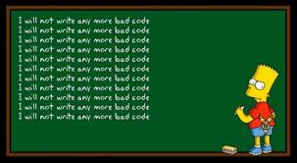
Understanding the Basics
There are two ways in which you can build your infrastructure:
Manually creating the infrastructure.
Through Automation.
One of the major benefits of automation is the code usability.
knowledge portal

Slide 108




Example of single service
Development
Staging
Production
knowledge portal

Slide 109

Using IAAC
Development
Staging
Production
knowledge portal

Slide 110

Benefits of Infrastructure as a Code
There are several benefits of designing your infrastructure as code:
Reusable Code
Managing infrastructure via source control.
Enable collaboration
knowledge portal

Slide 111
AWS Rekognition
Deep Learning

Slide 112
Overview of AWS Rekognition
AWS AWS Rekognition is a deep learning based virtual analysis service.
It allows us to easily integrate powerful visual analysis into our application
knowledge portal

Slide 113
Elastic Beanstalk
Orchestration

Slide 114








Traditional Deployment Approach
Use-Case: Deploy a simple Hello World application for production.
Resources to be created: AWS EC2, ELB, Auto-Scaling, Web-Server Configuration, and others.
DNS
Logs
EC2
ASG
Client
ELB
EC2 Resource
CloudWatch
knowledge portal

Slide 115
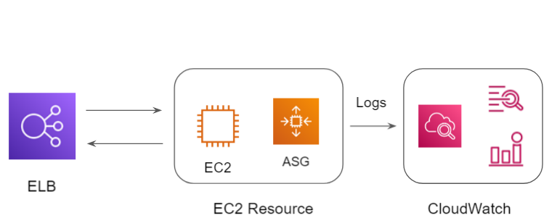

Elastic Beanstalk Deployment Approach
Use-Case: Deploy a simple Hello World application for production.
Create Elastic Beanstalk Environment
Elastic Beanstalk
knowledge portal

Slide 116
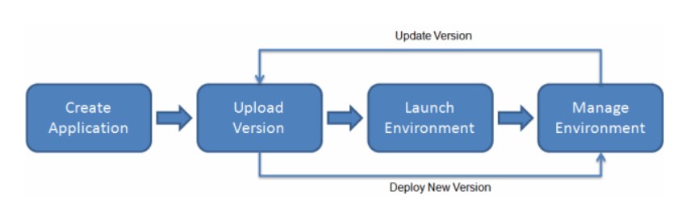
Overview of Elastic Beanstalk
AWS Elastic Beanstalk is an easy-to-use service for deploying and scaling web applications and services.
You can simply upload your code and Elastic Beanstalk automatically handles the deployment, from capacity provisioning, load balancing, auto-scaling to application health monitoring.
knowledge portal

Slide 117
Amazon Polly
Let’s Analyze

Slide 118

Overview of Amazon Polly
Amazon Polly is a service that turns text into lifelike speech.
It allows you to create applications that talk, and build entirely new categories of speech-enabled products
knowledge portal

Slide 119
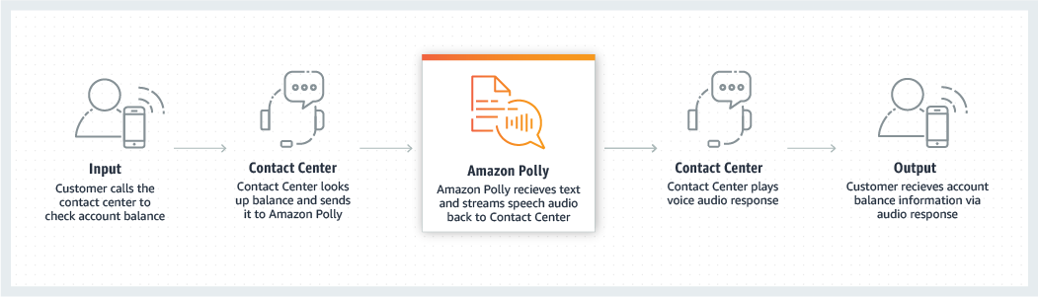
Sample Use-Case
knowledge portal

Slide 120
Amazon Workmail
Mail For AWS

Slide 121
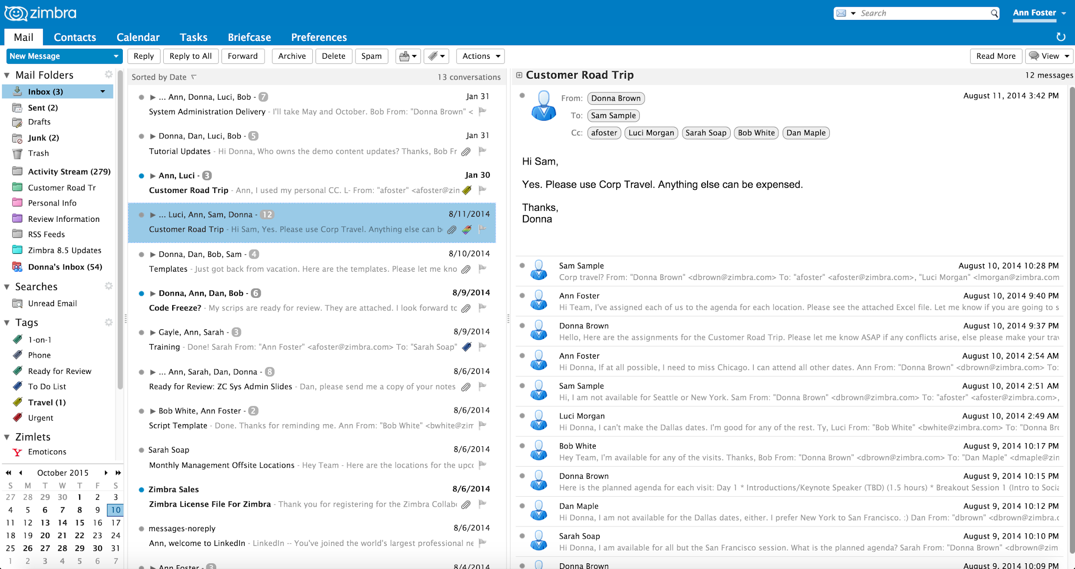
Challenges with Managing Mail Server
Configuring a Email Server for entire organization is a challenging task.
Various aspects related to Mail Server Configuration, SPAM Detection, Security, High-Availability comes into play.
knowledge portal

Slide 122
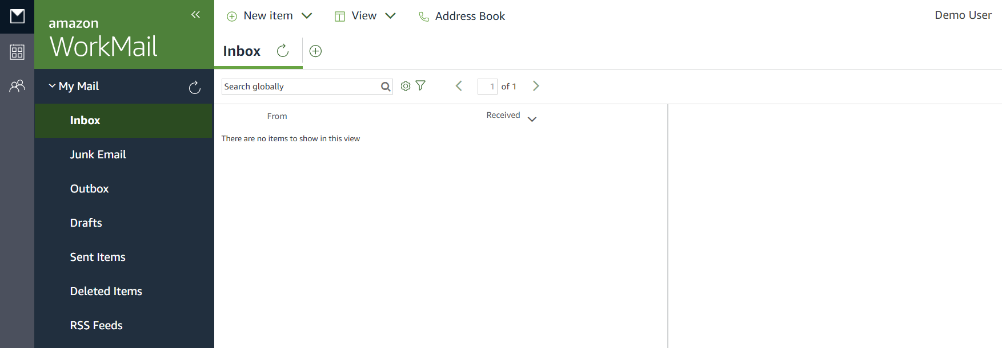
Overview of Amazon WorkMail
Amazon Workmail is a secure and managed business email service.
knowledge portal

Slide 123
Simple Workflow Service
Workflow execution

Slide 124
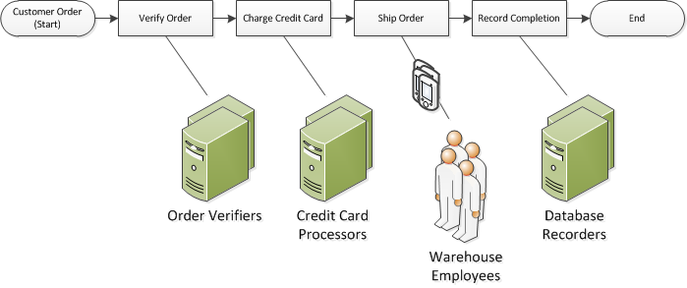
What is a Workflow?
A Workflow is a sequence of tasks that processes a set of data.
A workflow is a set of activities that carry out some objective
knowledge portal

Slide 125
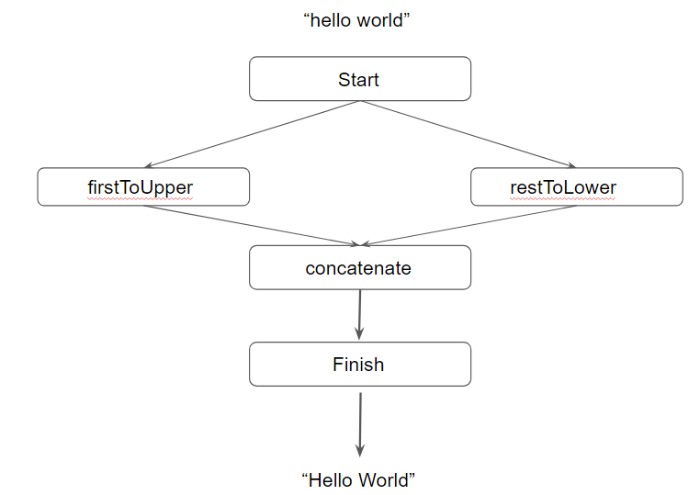
Overview of SWF
The Amazon Simple Workflow Service (Amazon SWF) makes it easy to build applications that coordinate work across distributed components.
knowledge portal

Slide 126
“hello world”
Start
firstToUpper
restToLower
concatenate
Finish
“Hello World”
knowledge portal

Slide 127
Overview of Activities
Activities are were the actual processing takes place.
function firstToUpper (input: String) {
return input[0].toUpperCase();
}
knowledge portal

Slide 128
Overview of Decider
Defines execution order of the processes.
Flow of input/output between multiple processes.
Conditionals and Concurrency.
One decider per workflow.
knowledge portal

Slide 129
AWS Batch
Running Batch Jobs

Slide 130
Getting Started
A batch job is a collection, or list, of commands that are processed in sequence often without requiring user input or intervention.
Generally batch jobs accumulate during working hours, and are then executed during the evening or another time the computer is idle.
Batch jobs wait in a job queue for processing when the system has the available resources.
knowledge portal

Slide 131
Overview of AWS Batch
AWS Batch enables developers, scientists, and engineers to easily and efficiently run hundreds of thousands of batch computing jobs on AWS.
AWS Batch dynamically provisions the optimal quantity and type of compute resources (e.g., CPU or memory optimized instances) based on the volume and specific resource requirements of the batch jobs submitted.
knowledge portal

Slide 132


Join us in our Adventure
kplabs.in/twitter
Be Awesome
kplabs.in/linkedin
instructors@kplabs.in

